Slide 1

J. Mutai

Slide 2
© 2012 ISACA. All rights reserved. No part of this publication may be used, copied, reproduced, modified, distributed, displayed, stored in a retrieval system or transmitted in any form by any means (electronic, mechanical, photocopying, recording or otherwise) without the prior written authorisation of ISACA. Use of this publication is permitted solely for personal use and must include full attribution of the material’s source. No other right or permission is granted with respect to this work.

Slide 3


Slide 4
Information!
Information is a key resource for all enterprises.
Information is created, used, retained, disclosed and destroyed.
Technology plays a key role in these actions.
Technology is becoming pervasive in all aspects of business and personal life.
What benefits do information and technology bring to enterprises?

Slide 5
Enterprise Benefits
Enterprises and their executives strive to:
Maintain quality information to support business decisions.
Generate business value from IT-enabled investments, i.e., achieve strategic goals and realise business benefits through effective and innovative use of IT.
Achieve operational excellence through reliable and efficient application of technology.
Maintain IT-related risk at an acceptable level.
Optimise the cost of IT services and technology.
How can these benefits be realised to create enterprise stakeholder value?

Slide 6
Stakeholder Value
Delivering enterprise stakeholder value requires good governance and management of information and technology (IT) assets.
Enterprise boards, executives and management have to embrace IT like any other significant part of the business.
External legal, regulatory and contractual compliance requirements related to enterprise use of information and technology are increasing, threatening value if breached.
COBIT 5 provides a comprehensive framework that assists enterprises to achieve their goals and deliver value through effective governance and management of enterprise IT.

Slide 7
The COBIT 5 Framework
Simply stated, COBIT 5 helps enterprises create optimal value from IT by maintaining a balance between realising benefits and optimising risk levels and resource use.
COBIT 5 enables information and related technology to be governed and managed in a holistic manner for the entire enterprise, taking in the full end-to-end business and functional areas of responsibility, considering the IT-related interests of internal and external stakeholders.
The COBIT 5 principles and enablers are generic and useful for enterprises of all sizes, whether commercial, not-for-profit or in the public sector.

Slide 8
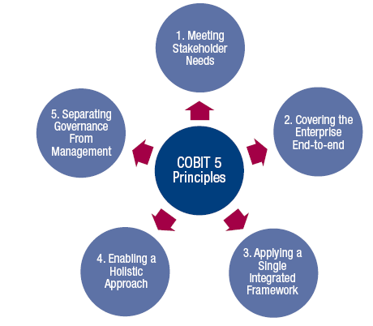
COBIT 5 Principles
Source: COBIT® 5, figure 2. © 2012 ISACA® All rights reserved.

Slide 9
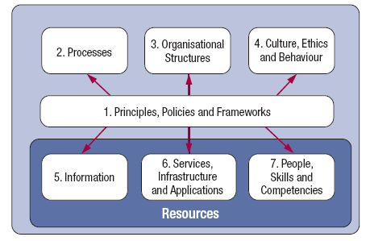
COBIT 5 Enablers
Source: COBIT® 5, figure 12. © 2012 ISACA® All rights reserved.

Slide 10
Governance and Management
Governance ensures that enterprise objectives are achieved by evaluating stakeholder needs, conditions and options; setting direction through prioritisation and decision making; and monitoring performance, compliance and progress against agreed-on direction and objectives (EDM).
Management plans, builds, runs and monitors activities in alignment with the direction set by the governance body to achieve the enterprise objectives (PBRM).

Slide 11
In Summary …
COBIT 5 brings together the five principles that allow the enterprise to build an effective governance and management framework based on a holistic set of seven enablers that optimises information and technology investment and use for the benefit of stakeholders.

Slide 12


Slide 13
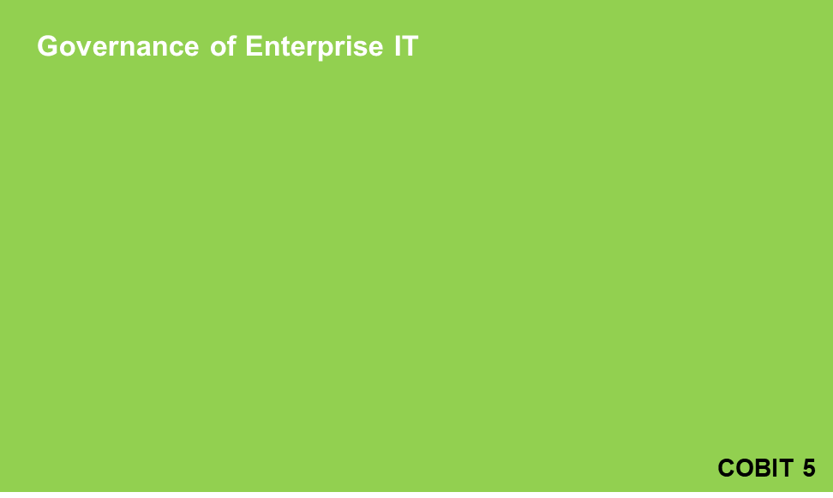
COBIT 5: Now One Complete Business Framework for
Evolution of scope
IT Governance
Val IT 2.0
(2008)
Management
Control
Risk IT
(2009)
Audit
COBIT1
COBIT2
COBIT3
COBIT4.0/4.1
1996
1998
2000
2005/7
2012
An business framework from ISACA, at www.isaca.org/cobit
© 2012 ISACA® All rights reserved.

Slide 14
COBIT 5 Framework
COBIT 5:
The main, overarching COBIT 5 product
Contains the executive summary and the full description of all of the COBIT 5 framework components:
  The five COBIT 5 principles
  The seven COBIT 5 enablers plus
  An introduction to the implementation guidance provided by ISACA (COBIT 5 Implementation)
  An introduction to the COBIT Assessment Programme (not specific to COBIT 5) and the process capability approach being adopted by ISACA for COBIT

Slide 15
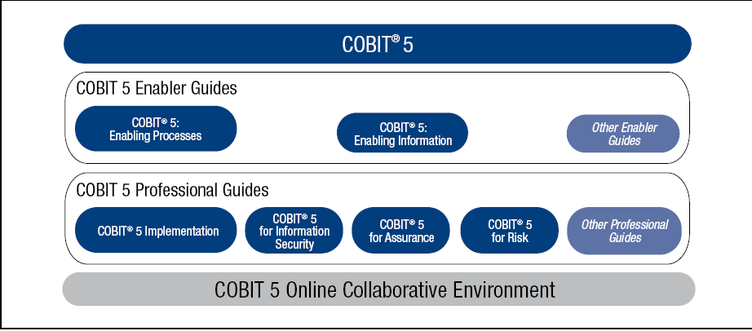
COBIT 5 Product Family
Source: COBIT® 5, figure 11. © 2012 ISACA® All rights reserved.

Slide 16
Five COBIT 5 Principles
The five COBIT 5 principles:
Meeting Stakeholder Needs
Covering the Enterprise End-to-end
Applying a Single Integrated Framework
Enabling a Holistic Approach
Separating Governance From Management

Slide 17
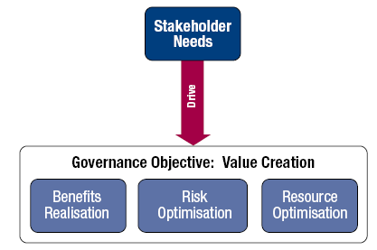
1. Meeting Stakeholder Needs
Principle 1. Meeting Stakeholder Needs
Enterprises exist to create value for their stakeholders.
Source: COBIT® 5, figure 3. © 2012 ISACA® All rights reserved.

Slide 18
1. Meeting Stakeholder Needs (cont.)
Principle 1. Meeting Stakeholder Needs:
Enterprises have many stakeholders, and ‘creating value’ means different—and sometimes conflicting—things to each of them.
Governance is about negotiating and deciding amongst different stakeholders’ value interests.
The governance system should consider all stakeholders when making benefit, resource and risk assessment decisions.
For each decision, the following can and should be asked:
Who receives the benefits?
Who bears the risk?
What resources are required?

Slide 19
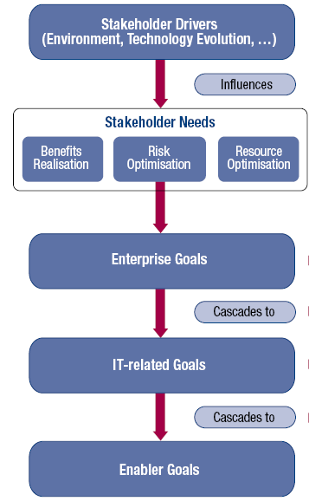
1. Meeting Stakeholder Needs (cont.)
Principle 1. Meeting Stakeholder Needs:
Stakeholder needs have to be transformed into an enterprise’s practical strategy.
The COBIT 5 goals cascade translates stakeholder needs into specific, practical and customised goals within the context of the enterprise, IT-related goals and enabler goals.
Source: COBIT® 5, figure 4. © 2012 ISACA® All rights reserved.

Slide 20
1. Meeting Stakeholder Needs (cont.)
Principle 1. Meeting Stakeholder Needs:
Benefits of the COBIT 5 goals cascade:
It allows the definition of priorities for implementation, improvement and assurance of enterprise governance of IT based on (strategic) objectives of the enterprise and the related risk.
In practice, the goals cascade:
  Defines relevant and tangible goals and objectives at various levels of responsibility.
  Filters the knowledge base of COBIT 5, based on enterprise goals to extract relevant guidance for inclusion in specific implementation, improvement or assurance projects.
  Clearly identifies and communicates how (sometimes very operational) enablers are important to achieve enterprise goals.

Slide 21
2. Covering the Enterprise End-to-end
Principle 2. Covering the Enterprise End-to-end:
COBIT 5 addresses the governance and management of information and related technology from an enterprisewide, end-to-end perspective.
This means that COBIT 5:
  Integrates governance of enterprise IT into enterprise governance, i.e., the governance system for enterprise IT proposed by COBIT 5 integrates seamlessly in any governance system because COBIT 5 aligns with the latest views on governance.
  Covers all functions and processes within the enterprise; COBIT 5 does not focus only on the ‘IT function’, but treats information and related technologies as assets that need to be dealt with just like any other asset by everyone in the enterprise.

Slide 22
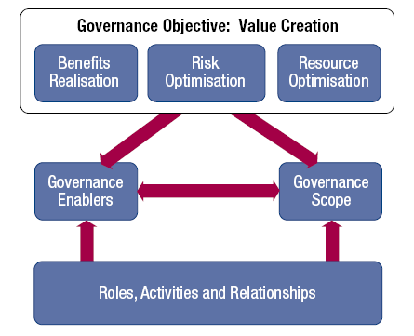
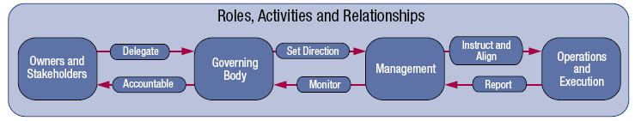
2. Covering the Enterprise End-to-end (cont.)
Principle 2. Covering the Enterprise End-to-end
Key components of a governance system
Source: COBIT® 5, figure 8. © 2012 ISACA® All rights reserved.
Source: COBIT® 5, figure 9. © 2012 ISACA® All rights reserved.

Slide 23
3. Applying a Single Integrated Framework
Principle 3. Applying a Single Integrated Framework:
COBIT 5 aligns with the latest relevant other standards and frameworks used by enterprises:
  Enterprise: COSO, COSO ERM, ISO/IEC 9000, ISO/IEC 31000
  IT-related: ISO/IEC 38500, ITIL, ISO/IEC 27000 series, TOGAF, PMBOK/PRINCE2, CMMI
This allows the enterprise to use COBIT 5 as the overarching governance and management framework integrator.
ISACA plans a capability to facilitate COBIT user mapping of practices and activities to third-party references.

Slide 24
4. Enabling a Holistic Approach
Principle 4. Enabling a Holistic Approach
COBIT 5 enablers are:
Factors that, individually and collectively, influence whether something will work—in the case of COBIT, governance and management over enterprise IT
Driven by the goals cascade, i.e., higher-level IT-related goals define what the different enablers should achieve
Described by the COBIT 5 framework in seven categories

Slide 25
4. Enabling a Holistic Approach (cont.)
Principle 4. Enabling a Holistic Approach
Source: COBIT® 5, figure 12. © 2012 ISACA® All rights reserved.

Slide 26
4. Enabling a Holistic Approach (cont.)
Principle 4. Enabling a Holistic Approach:
Processes—Describe an organised set of practices and activities to achieve certain objectives and produce a set of outputs in support of achieving overall IT-related goals
Organisational structures—Are the key decision-making entities in an organisation
Culture, ethics and behaviour—Of individuals and of the organisation; very often underestimated as a success factor in governance and management activities
Principles, policies and frameworks—Are the vehicles to translate the desired behaviour into practical guidance for day-to-day management
Information—Is pervasive throughout any organisation, i.e., deals with all information produced and used by the enterprise. Information is required for keeping the organisation running and well governed, but at the operational level, information is very often the key product of the enterprise itself.
Services, infrastructure and applications—Include the infrastructure, technology and applications that provide the enterprise with information technology processing and services
People, skills and competencies—Are linked to people and are required for successful completion of all activities and for making correct decisions and taking corrective actions

Slide 27
4. Enabling a Holistic Approach (cont).
Principle 4. Enabling a Holistic Approach:
Systemic governance and management through interconnected enablers—To achieve the main objectives of the enterprise, it must always consider an interconnected set of enablers, i.e., each enabler:
  Needs the input of other enablers to be fully effective, e.g., processes need information, organisational structures need skills and behaviour
  Delivers output to the benefit of other enablers, e.g., processes deliver information, skills and behaviour make processes efficient
This is a KEY principle emerging from the ISACA development work around the Business Model for Information Security (BMIS).

Slide 28
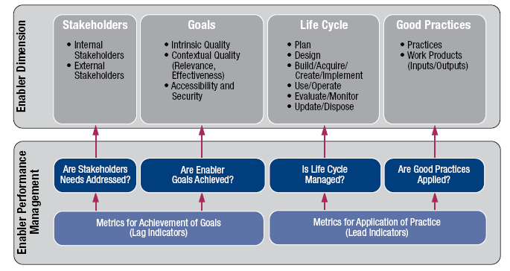
4. Enabling a Holistic Approach (cont).
Principle 4. Enabling a Holistic Approach
COBIT 5 Enabler Dimensions:
All enablers have a set of common dimensions. This set of common dimensions:
  Provides a common, simple and structured way to deal with enablers
  Allows an entity to manage its complex interactions
  Facilitates successful outcomes of the enablers
Source: COBIT® 5, figure 13. © 2012 ISACA® All rights reserved.

Slide 29
5. Separating Governance From Management
Principle 5. Separating Governance From Management:
The COBIT 5 framework makes a clear distinction between governance and management.
These two disciplines:
  Encompass different types of activities
  Require different organisational structures
  Serve different purposes
Governance—In most enterprises, governance is the responsibility of the board of directors under the leadership of the chairperson.
Management—In most enterprises, management is the responsibility of the executive management under the leadership of the CEO.

Slide 30
5. Separating Governance From Management (cont.)
Principle 5. Separating Governance From Management:
Governance ensures that stakeholders needs, conditions and options are evaluated to determine balanced, agreed-on enterprise objectives to be achieved; setting direction through prioritisation and decision making; and monitoring performance and compliance against agreed-on direction and objectives (EDM).
Management plans, builds, runs and monitors activities in alignment with the direction set by the governance body to achieve the enterprise objectives (PBRM).

Slide 31
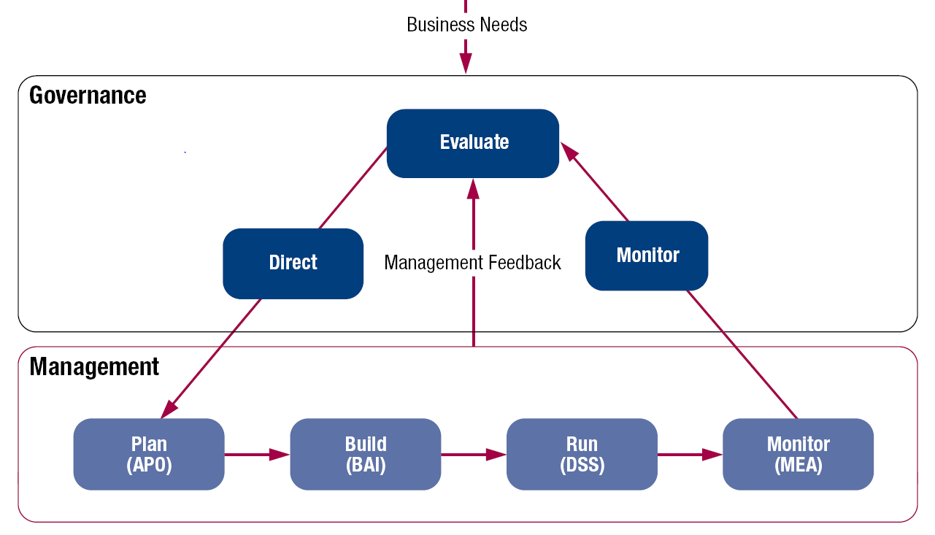
5. Separating Governance From Management (cont.)
Principle 5. Separating Governance From Management:
COBIT 5 is not prescriptive, but it advocates that organisations implement governance and management processes such that the key areas are covered, as shown.
Source: COBIT® 5, figure 15. © 2012 ISACA® All rights reserved.

Slide 32
5. Separating Governance From Management (cont.)
Principle 5. Separating Governance from Management:
The COBIT 5 framework describes seven categories of enablers (Principle 4). Processes are one category.
An enterprise can organise its processes as it sees fit, as long as all necessary governance and management objectives are covered. Smaller enterprises may have fewer processes; larger and more complex enterprises may have many processes, all to cover the same objectives.
COBIT 5 includes a process reference model (PRM), which defines and describes in detail a number of governance and management processes. The details of this specific enabler model can be found in the COBIT 5: Enabling Processes volume.

Slide 33


Slide 34
COBIT 5: Enabling Processes
COBIT 5: Enabling Processes complements COBIT 5 and contains a detailed reference guide to the processes that are defined in the COBIT 5 process reference model:
  In Chapter 2, the COBIT 5 goals cascade is recapitulated and complemented with a set of example metrics for the enterprise goals and the IT-related goals.
  In Chapter 3, the COBIT 5 process model is explained and its components defined.
  Chapter 4 shows the diagram of this process reference model.
  Chapter 5 contains the detailed process information for all 37 COBIT 5 processes in the process reference model.

Slide 35
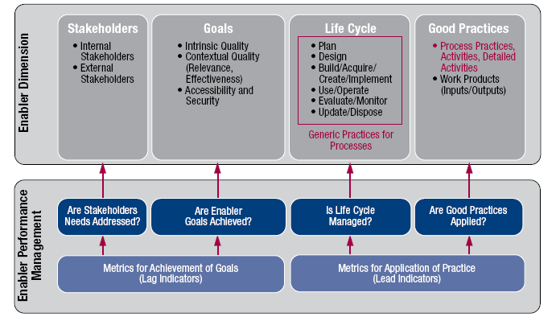
COBIT 5: Enabling Processes (cont.)
Source: COBIT® 5, figure 29. © 2012 ISACA® All rights reserved.

Slide 36
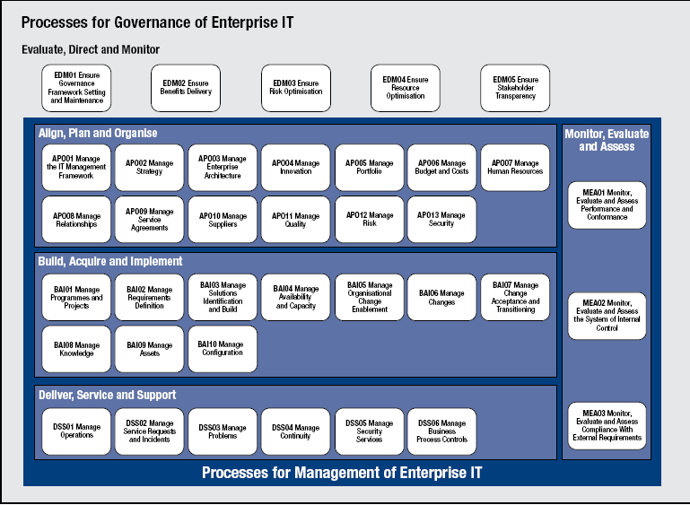
COBIT 5: Enabling Processes (cont.)
Source: COBIT® 5, figure 16. © 2012 ISACA® All rights reserved.

Slide 37
COBIT 5: Enabling Processes (Cont.)
COBIT 5: Enabling Processes:
The COBIT 5 process reference model subdivides the IT-related practices and activities of the enterprise into two main areas—governance and management— with management further divided into domains of processes:
  The GOVERNANCE domain contains five governance processes; within each process, evaluate, direct and monitor (EDM) practices are defined.
  The four MANAGEMENT domains are in line with the responsibility areas of plan, build, run and monitor (PBRM).

Slide 38


Slide 39
COBIT 5 Implementation
The improvement of the governance of enterprise IT (GEIT) is widely recognised by top management as an essential part of enterprise governance.
Information and the pervasiveness of information technology are increasingly part of every aspect of business and public life.
The need to drive more value from IT investments and manage an increasing array of IT-related risk has never been greater.
Increasing regulation and legislation over business use of information is also driving heightened awareness of the importance of a well-governed and managed IT environment.

Slide 40
COBIT 5 Implementation (cont.)
ISACA has developed the COBIT 5 framework to help enterprises implement sound governance enablers. Indeed, implementing good GEIT is almost impossible without engaging an effective governance framework. Best practices and standards are also available to underpin COBIT 5.
Frameworks, best practices and standards are useful only if they are adopted and adapted effectively. There are challenges that need to be overcome and issues that need to be addressed if GEIT is to be implemented successfully.
COBIT 5: Implementation provides guidance on how to do this.

Slide 41
COBIT 5 Implementation (cont.)
COBIT 5: Implementation covers the following subjects:
  Positioning GEIT within an enterprise
  Taking the first steps towards improving GEIT
  Implementation challenges and success factors
  Enabling GEIT-related organisational and behavioural change
  Implementing continual improvement that includes change enablement and programme management
  Using COBIT 5 and its components

Slide 42
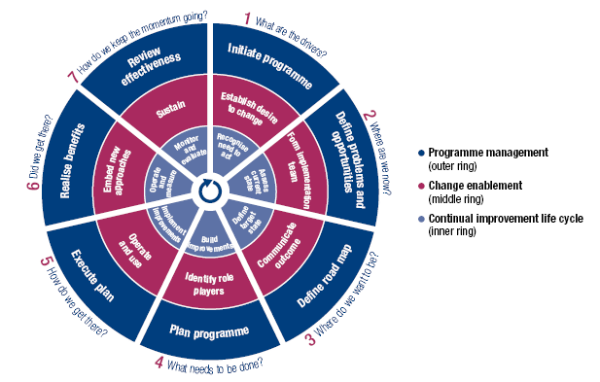
COBIT 5 Implementation (cont.)
Source: COBIT® 5, figure 17. © 2012 ISACA® All rights reserved.

Slide 43


Slide 44
COBIT 5 Product Family
Source: COBIT® 5, figure 11. © 2012 ISACA® All rights reserved.

Slide 45
COBIT 5 Future Supporting Products
Future supporting products:
Professional Guides:
  COBIT 5 for Information Security
  COBIT 5 for Assurance
  COBIT 5 for Risk
Enabler Guides:
  COBIT 5: Enabling Information
COBIT Online Replacement
COBIT Assessment Programme:
  Process Assessment Model (PAM): Using COBIT 5
  Assessor Guide: Using COBIT 5
  Self-assessment Guide: Using COBIT 5

